Slide 1
Option
From Data Analyzer to Decision Enabler to Business Driver
How To Elevate your Organization’s Data Analytics Maturity
CDAO Dallas 2024
David Morley
Former Director of Data Governance at US Treasury
david.morley@protiviti.com
(214) 566-3647

Slide 2


D&A related business market forces
Modern business models recognize D&A as critical and a force multiplier when working symbiotically with Business Strategy and IT Strategy to address today’s ever-evolving market forces
CEO
COO
CFO
CRO
CIO / CTO
Business Heads
Build and Sustain Customer Trust
Environmental Social and Corporate Governance (ESG)
Navigate & Capitalize on Industry Disruptors
Enable Resilient Operations
Build & Sustain Operational Excellence
Address Modern Talent & Skillset Gaps
Asset & Liability Management (ALM)
Improve Forecasting & Budgeting
Manage Margin & Cost Pressures
Monetize Data Assets
Maintain Positive Regulator Relations
Comply with Privacy & Security Expectations
Keep up with modern business & IT risk
Establish Data Risk Oversight function
Enable Business, Technology, & Digital Strategies
Leverage Cloud to Break Down Data Silos & Participate in Marketplaces & Ecosystems
Increase Data & Analytics Literacy
Anticipate Customer Needs
Attract New & Grow Existing Customer Wallet Share
Enable Innovation & New Product Development
Democratize Data Access & Usage

Slide 3
Common business cases for D&A
Business cases for data & analytics capabilities crop up in virtually every business and IT conversation
We have 5 different views of the same customer
We don’t have a clear understanding of all the places where sensitive information resides
We need to better understand the bottlenecks within our operations
We know we need to go to the cloud but we’re not sure the best approach to getting there
Our competitors seem to be nimbler than us in making, and operationalizing decisions
We are missing out on opportunities to cross-sell products to our customers
We are unable to rely on the numbers in the reports we utilize for Board reporting

Slide 4

Establishing the Foundations of Data & Analytics Enablement
Policies, processes & standards
Measurement & monitoring
Policies & Rules
Processes
Controls
Data Standards & Definitions
Metadata, Taxonomy, Cataloging, and Classification
Statistics and Analysis
Tracking of progress
Monitoring of issues
Continuous Improvement
Score--carding
Organization
Technology
Operating Model
Decision Makers & Escalation Points
Data Governance Organization Members
Roles and Responsibilities
Data Ownership & Accountability
Data Quality & Lineage Tools
Data Mastering & Sharing
Data Architecture & Security
Stewardship Workflows
Business Glossary & Metadata Repository
Strategy
Change management
Communication
Vision & Mission
Objectives & Goals
Alignment with Corporate Objectives
Alignment with Business Strategy
Guiding Principles
Business impact & readiness
IT operations & readiness
Training & awareness
Stakeholder management & communication
Defining ownership & accountability
Communication Plan
Mass Communication
Individual Updates
Mechanisms
Training Strategy
Data Governance

Slide 5
Data maturity assessment- Continuum of analytics
Moving from hindsight, to insight, to foresight
Traditional analytics
(Data management, BI and reporting)
Advanced analytics
(Analytics-enabled decision making)
Analytics-enabled
decision making
How can we
make it happen?
Improve speed & quality of decision making to confirm that analytic-enabled insights are turned into both actions and measurable outcomes that drive higher performance
Prescriptive analytics
Proactive, intelligent and self-learned decisions
Predictive
Analytics
Apply logic, business rules, algorithms, statistical models and analysis combined with industry-focused management consulting methods to develop insights
What will happen?
Foresight
Descriptive
Analytics
Predictive analytics
Improve business performance with appropriate, actionable, timely data and information
Added value to the business
To whom it happened?
Data
mgmt
Comparative analytics
Improve business process and insights with information strategy, architecture and governance to achieve a ‘single source of the truth’
Why did it happen?
Insight
Reactive
What happened?
Diagnostic analytics
Descriptive analytics
Hindsight
Analytical sophistication

Slide 6
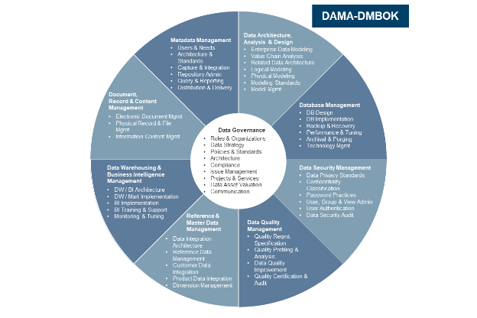
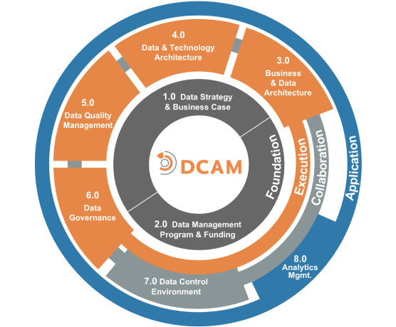
Getting started: Understand your maturity
Combine leading practices with those of commonly utilized industry models (e.g., EDMC-DCAM and DAMA-DMBoK) to ensure holistic, industry comparable analysis and recommendations that are tailored your specific circumstances and maturity goals.
Phase I
Phase II
Phase III
Phase IV
Program assessment
& gaps
(4-6 weeks)
Gap analysis & recommendations
(2-3 weeks)
Roadmap develop and stakeholder communication
(1-2 week)
Pivot to business use case-driven implementation
Future phase
Knowledge transfer
Support organizational change
Recommending a three-phased approach; typically, 8-10 weeks in duration
Phase I will involve reviewing current state data management artifacts while interviewing key stakeholders to define specific risks regarding your current data management practices. Next will be to discuss key themes, pain points, high level functional requirements, and high-level technical requirements during the interview sessions. You can then evaluate the results against a blend of expertise and industry standard models, such as the DAMA DMBOK¹ and DCAM² to support ranking activities against a maturity model.
Phase 2 leverages information and gaps identified in phase 1 combined with industry leading practices to analyze your gaps and preferred maturity levels to develop recommendations. Validation sessions will be held with key stakeholders to confirm recommendations.
Phase 3 leverages these recommendations to define the list of initiatives that will minimize and eventually eliminate organizational, functional, and technical gaps between the current and future state. Additionally, work with key stakeholders to prioritize initiatives, document key gap themes, and plot the initiatives on a timeline. Finally, you can then deliver recommendations to project sponsors and key stakeholders focusing on maintaining forward, actionable momentum.
¹DMBoK - Data Management Body of Knowledge
²Data Management Capability Assessment Model

Slide 7
Relevant use cases
Proven data and analytics capabilities support organizations at every step of their data and analytics journey
Data & analytics strategy
Data governance
Master data management
Data architecture & engineering
BI reporting & analytics
Data & analytics maturity assessment to enable secure, resilient, and scalable data & insights
Establishment of models and strategies to support compliance and risk mitigation for data
Clear strategies for the creation and management of key master data domains
Establish a cloud-based data & analytics architecture to enable modern, ever-evolving business models
Develop modern business intelligence & visualization capabilities to support better storytelling
Business value-driven data & analytics strategy & roadmap
Creation of data catalogs, dictionaries, and other key artifacts to help further understand our data assets
Definitions for key master data domains such as customer, vendor, material, employee, and others
Develop a data sharing marketplace leveraging AWS and Snowflake to fuel advanced analytics
Effectively balance reporting / dashboarding with the need for self-service data analysis
Use case ideation and assessment to determine opportunities to monetize data & analytics assets
Establishment of ownership, stewardship, and accountability models for key data assets
Architectures and technology best practices for the management of master data domains
Establish a “privacy by design” data & analytics architecture
Develop forward-looking analytics insights to predict customer spend
Modern data & analytics operating model development and skills analysis
Identification of and remediation for data quality challenges across the enterprise
Enablement support for data quality with master data management domains across people, process, and technology
Enable an API marketplace to enable digital transformation & real-time UI / UX
Build and operate a reporting & analytics shared service to provide rapid deployment of insights

Slide 8
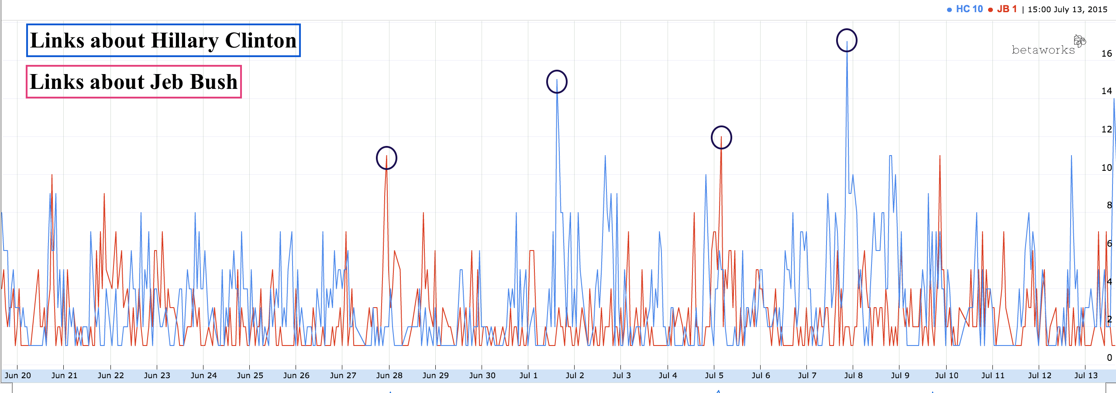
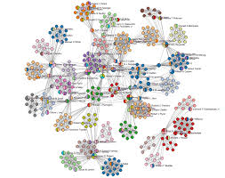
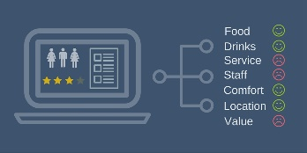

To accelerate outcomes deploy next gen analytical techniques
Leveraging multiplicity of data sources
  Transactional, social, financial, government records, forensic, device/digital data, etc.
Combining automated learning from data with human judgement and feedback
Adaptive to changing behaviors
Significant improvement in business outcomes
  E.g. Better quality leads for investigation
Deep Learning
Active & Reinforced Learning
Link
Analysis
Enterprise solution
Example of analytical techniques
Semantic modelling of data from multiple sources
Real-time Analytics
Explainable AI
Time Series Analysis
Knowledge Graph
Modeling Dynamics of Entities over time which leads to behavioral analysis
A Combined graph that incorporates social, financial and news/political data
Natural Language Processing
Multi-agent Systems
Aspect Based Sentiment
Cross-lingual and Multilingual
Big
Data
Modeling Dynamics of Entities over time which leads to behavioral analysis
Insight without language barriers

Slide 9




National treasury program case study– Data governance maturity assessment
Organization Challenge
Solution Delivered
Task was establishing data governance and analytics practices to support 10 treasury programs totaling close to $600 billion in CARES act fund grants consistency in terms of public access to data, compliance, and meet regulatory demands.
The agency assisted by oversight partners conducts regular assessments of the program and its’ maturity, and task here is running a maturity assessment of all aspects of the program and to provide recommendations for future state improvements.
Assessed current functions of governance against an industry DG model.
Met with groups from across the agency (finance, recipient monitoring, compliance, operations, it, and others) to determine current practices for data governance.
Met with cross industry leaders from other agencies and oversight partners.
Provided findings to document our assessment of the current maturity.
Created a maturity model, with supporting details, and presented to executive management.
Business results
Identification of agency challenges for adoption of enterprise data governance.
Provided a maturity assessment comparing the current state against the proposed future state needs.
Outlined overall recommendations for how to meet the future state and presented roadmap with budgets and timeline.

Slide 10
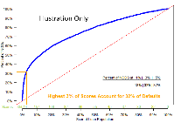

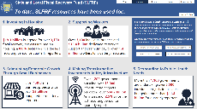

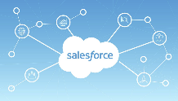

Data maturity assessment
10 US treasury programs
Traditional analytics
(Data management, BI and reporting)
Advanced analytics
(Analytics-enabled decision making)
Analytics-enabled
decision making
How can we
make it happen?
Apply model and merged outputs back into grants management system to answer “what if” answers as well as optimize solutions
Prescriptive
analytics
Proactive, intelligent and self-learned decisions
Predictive
Analytics
Apply logic, business rules, algorithms, statistical models and analysis combined with expert consulting methods to develop insights in forecasting expenditures and compliance monitoring
What will happen?
Foresight
Descriptive
Analytics
Predictive analytics
Utilize EDM, power-bi, python, SQL to create kpis, reports and other tools to assist agency, public and agency partners to monitor and improve performance of programs
Added value to the business
To whom it happened?
Data
mgmt
Comparative analytics
Design, streamline and governance of salesforce grants management system for reporting, compliance, and recipient monitoring.
Why did it happen?
Insight
Reactive
What happened?
Diagnostic analytics
Descriptive analytics
Hindsight
Analytical sophistication

Slide 11


More information
Protiviti Global Business Consulting
  https://www.protiviti.com
DMBoK - Data Management Body of Knowledge
  https://www.dama.org/cpages/body-of-knowledge
Data Management Capability Assessment Model
  https://dgpo.org/wp-content/uploads/2016/06/EDMC_DCAM_-_WORKING_DRAFT_VERSION_0.7.pdf
Assistance for State and State and Local Tribal Governments (ERA, HAF, SLFRF, CPF, LATCF, CRF)
  https://home.treasury.gov/policy-issues/coronavirus/assistance-for-state-local-and-tribal-governments
Assistance for American Industry (CERTS and PSP)
  https://home.treasury.gov/policy-issues/coronavirus/assistance-for-american-industry
Assistance for Small Businesses (ECIP, SSBCI)
  https://home.treasury.gov/policy-issues/coronavirus/assistance-for-small-businesses
Treasury developed the Economic Recovery Learning Agenda designed to identify important research questions to better understand the impact of its programs. https://home.treasury.gov/system/files/136/ORP-Learning-Agenda-Final.pdf

