Slide 1
overall_0_132581393581893391 columns_1_132581393581893391
Lee Whatford
CISM CRISC
CISO – Domino’s pizza group UK&I

Slide 2
contents
Threat landscape
Accepting the challenge
Establishing a Framework for Threat Driven Vulnerability Management
Identifying and Hiring talent…

Slide 3
A bit about me…
25(+) Years in Infosec
Extensive experience Supply Side
6 years now in Head Of and CISO roles
Drives Efficiencies AND Effectiveness in security transformation

Slide 4
A bit about domino’s…
Manufacturing, end to end supply chain
Digital platform processing £1.5Bn in 2021
Award Winning Mobile app
80+ FPs operating almost 1300 stores

Slide 5
Threat landscape
A real challenge
Ever developing, rapidly pivoting
Well funded, extremely well networked
Huge infrastructure
Use of AI to speed up coding
Kids using MALWARE aaS
Only have to find one weakness…

Slide 6
Threat landscape
How do we shift the odds?
Excellent intelligence feeds (trick is to be relevant AND actionable)
Tracking of Threat Actors is now available (Thanks to highly sophisticated IR intel)
Framework for application – MITRE (www.mitre.org) ATT&CK / D3FEND
Become MUCH more targeted in our approach to Vulnerability Management
Answer the SO WHAT? about why we’re fixing vulnerabilities
Leverage ML/AI – relying on machines to think and respond QUICKLY

Slide 7
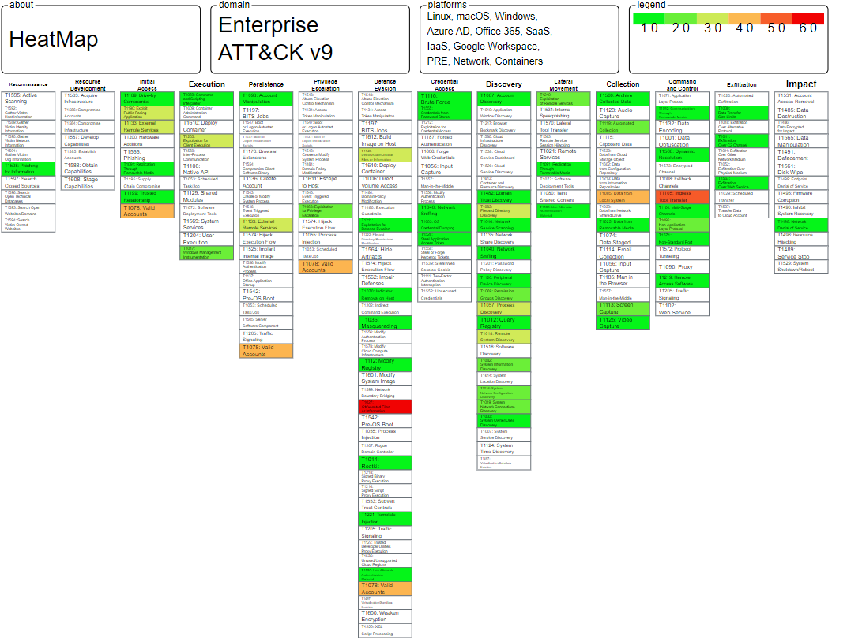
Continual control validation

Slide 8
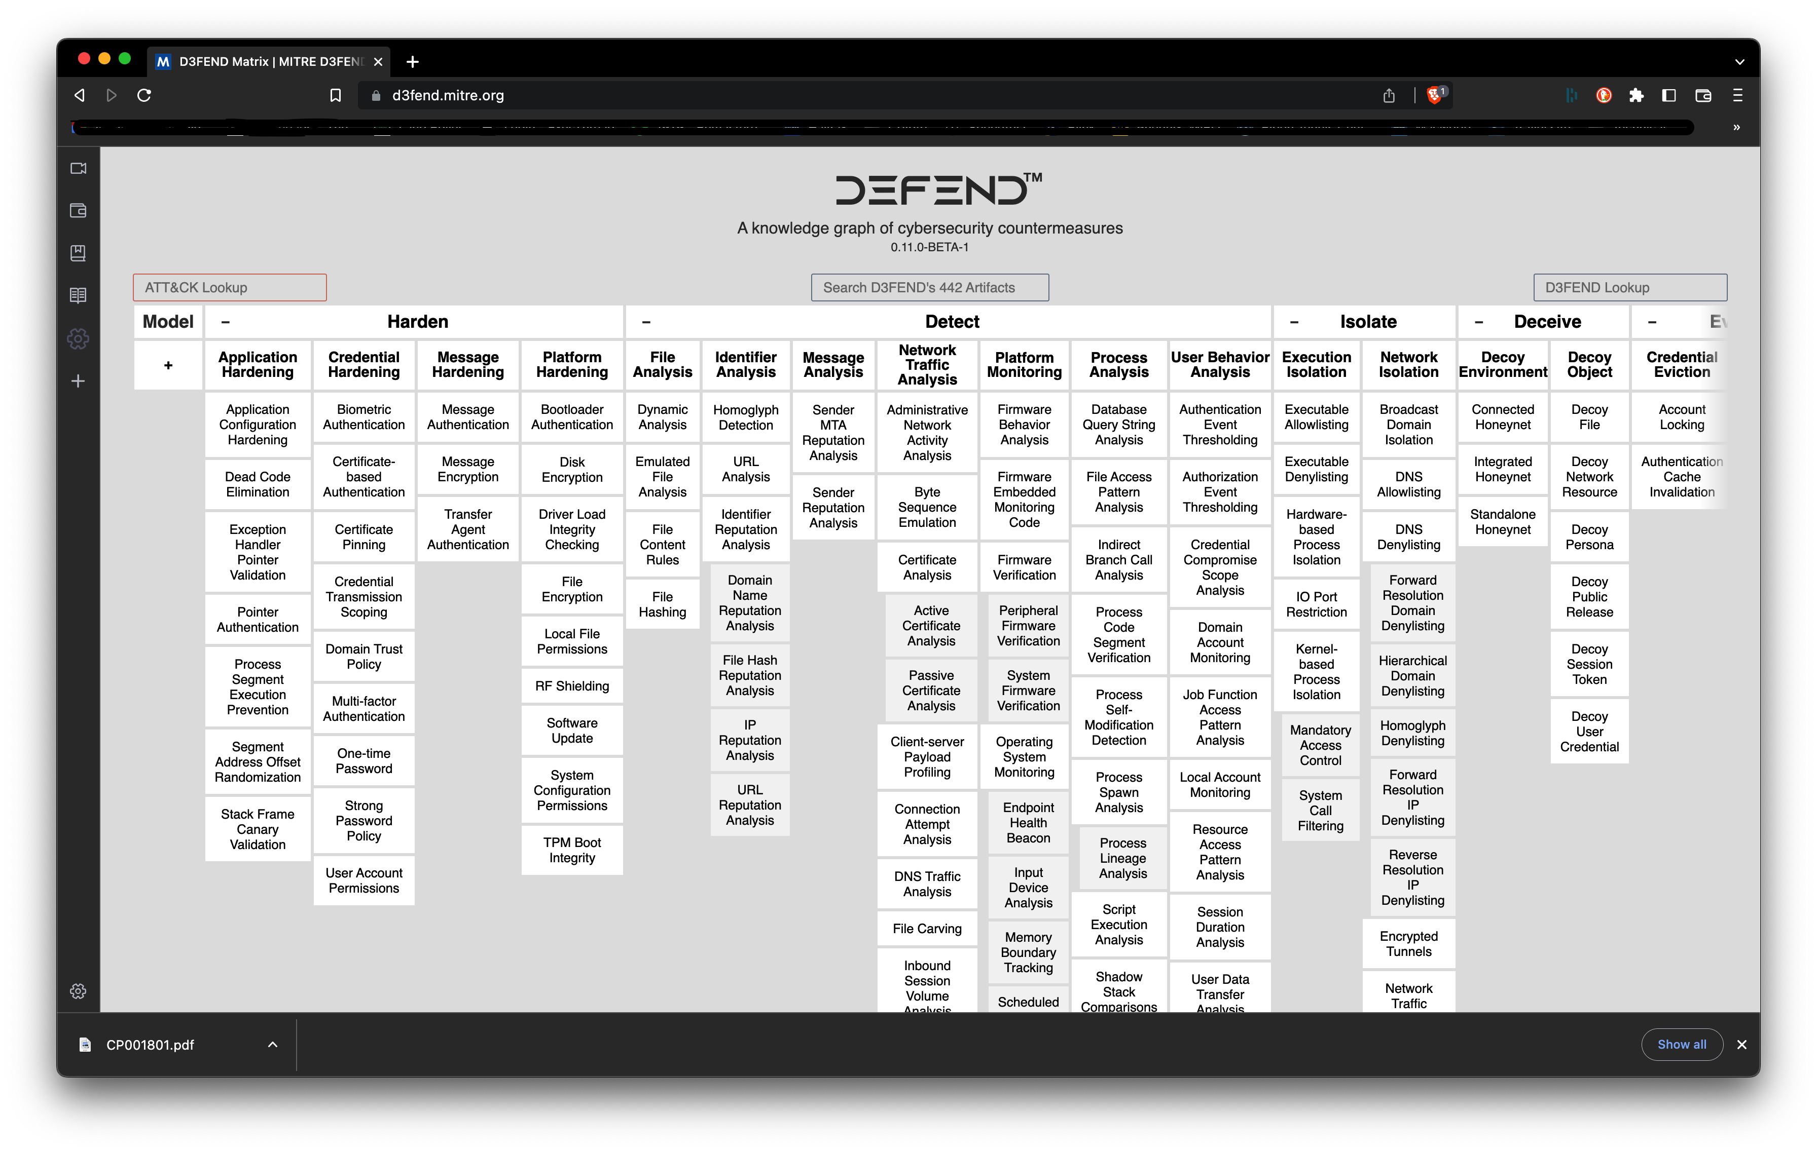

Slide 9
How do we think about risk?
RISK
LIKELIHOOD
X
IMPACT
?????
££££?
Of…
Being Targetted
Being Attacked
Being Breached
Acheving Persistance
Stealing Crown Jewels
Business Disruption
Relevant
Quantified
Aligned to Business Strategy
Don’t make it up…

Slide 10
We need a framework – better risk management
RISK
THREAT
VULNERABILITY
IMPACT
CVSS
ASSET
EXPLOITABILITY
EXPLOITATION
KILL CHAIN
COMPENSATING CONTROLS
THREAT RELEVANT
RELEVANCE
TTPs / MITRE
INTELLIGENCE DRIVEN
RELEVANT
ACTIONABLE
££££?
Continual
Control
Validation

Slide 11
Talent spotting
Key Factors
Attitude
Aptitude
Background
Diversity
Pipeline
Keen
Competence
Variety
Gender
Hire People to move them on
Willing to Learn
Takes on board new things
Leadership
Perspective
Ethnicity
Fresh thinking
Task Orientated
Outcome Driven

Slide 12
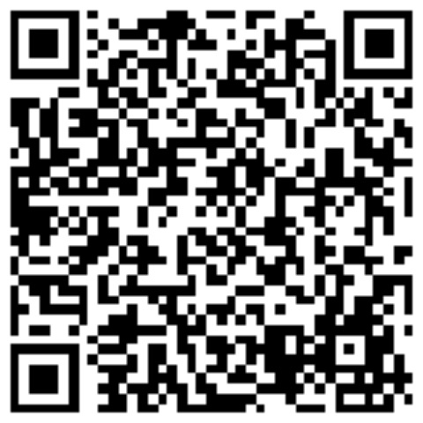
Thank you
overall_0_132581393581893391 columns_1_132581393581893391
www.linked.com/in/leewhatford
Feel free to Link In with me and we can continue the conversation

