Slide 1
Top Cloud Threats and steps to mitigate the risks
Chris Wang, Enterprise Solutions Engineer, Wiz
16 February 2023
Notes:
Hello, my name is Chris Wang an Enterprise Solutions Engineer at Wiz.
Today we going to talk about the Top Cloud Threats and how to mitigate them.

Slide 2
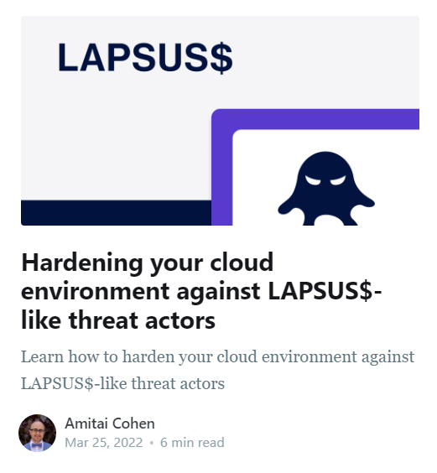
The team behind the top cloud threats
30 | <1 | 200 | 10+
Security researchers and analysts | Day to detect critical threats | Critical risk detections in customer environments | Distinct cybersecurity domains
Inter-disciplinary research
Focus on context and risks to cloud environments
Practical & actionable research – tied to a customer action
Continuously adding security content to Wiz
Quick response - Added Log4Shell detection < 8 hours from publication
Notes:
As a cloud security product company, Wiz has some of the top cloud security researchers in the world.
Our inter-disciplinary Threat Researchers look at the latest security threats in cloud on an ongoing basis. When they find any new threats, they respond to them by creating detection in the Wiz product and publishing actionable threat advisories to our customers. For example, in the case of Log4Shell, Wiz was able to add the detection within 8 hours after the publication of the vulnerability.
From their work, I have selected the top 4 of those cloud threats. To make this presentation actionable, I will also talk about the remediation steps.

Slide 3
1
API security threats
2
Lapsus$-like attacks
Agenda
3
Data exposure
4
Supply chain threats
Notes:
These are 4 types of cloud threats I am going to talk about today.
(Read the bullet points.)

Slide 4
Cloud Threat: API Security

Slide 5
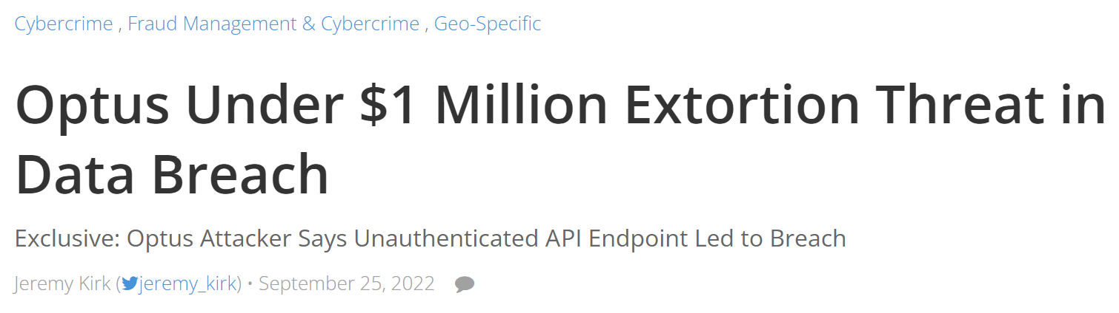
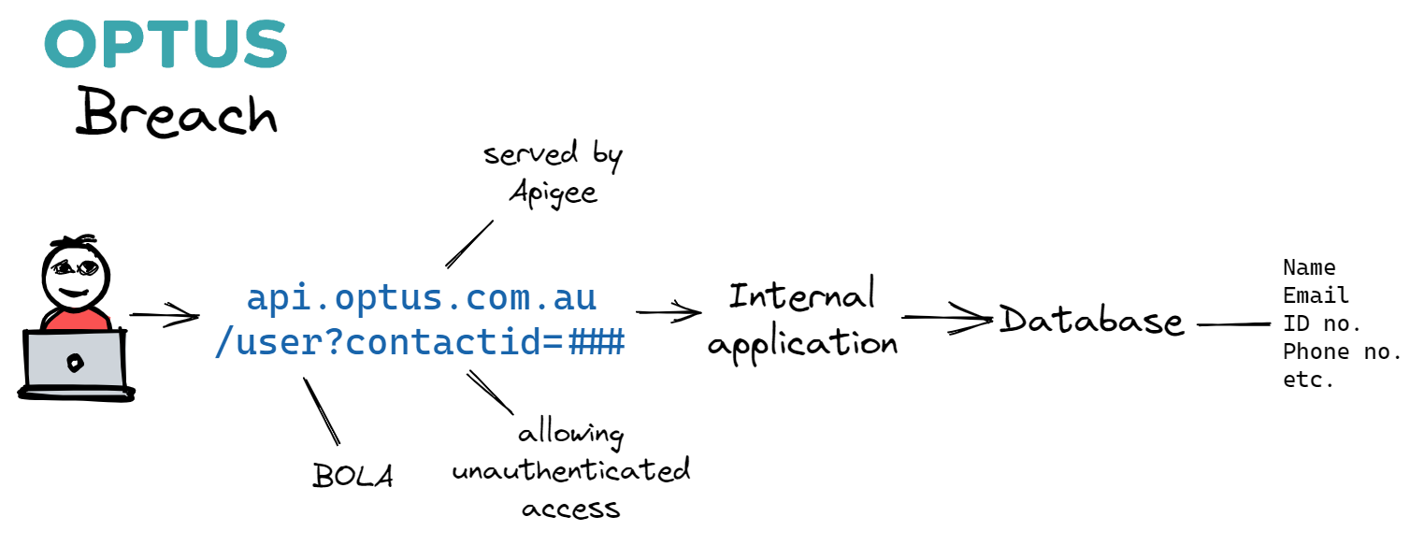
API Security: Optus breach
11mil customer records leaked through an unauthenticated API end-point
Notes:
The API security threat was brought under the spotlight in September 2022 with the Optus data breach.
Opus, Australia’s second-largest telco, faced $1 million extortion demand to prevent the sale 11 million sensitive customer records.
By piecing up the news coverage on this, we know at least 3 things have gone wrong.
An API endpoint was unintentionally publicly exposed. In fact, the hostname of the API endpoint “api.optus.com.au” was easily guessable.
The API endpoint was misconfigured API endpoint (in Apigee), allowing unauthenticated access
3. BOLA: Broken Object Level Authorization. In this case, it allowed the attacker to easily enumerate the customer records using the ”contacteId” parameter. In fact, BOLA is the No. 1 threat in the OWASP API Security Top 10
And the combination of the 3 risks enabled the attacker to abuse the Optus API in order to extract the sensitive data.
---
https://www.bankinfosecurity.com/optus-under-1-million-extortion-threat-in-data-breach-a-20142
https://twitter.com/Jeremy_Kirk/status/1573652986437726208
https://blog.shiftleft.io/the-optus-breach-how-bad-code-keeps-happening-to-good-companies-189bb11bcf42
https://www.optus.com.au/about/media-centre/media-releases/2022/09/optus-notifies-customers-of-cyberattack
https://securityboulevard.com/2022/10/owasp-api-vulnerabilities-exploited-to-bypass-api-security/
https://nonamesecurity.com/learn-api-01-broken-object-level-authorization

Slide 6
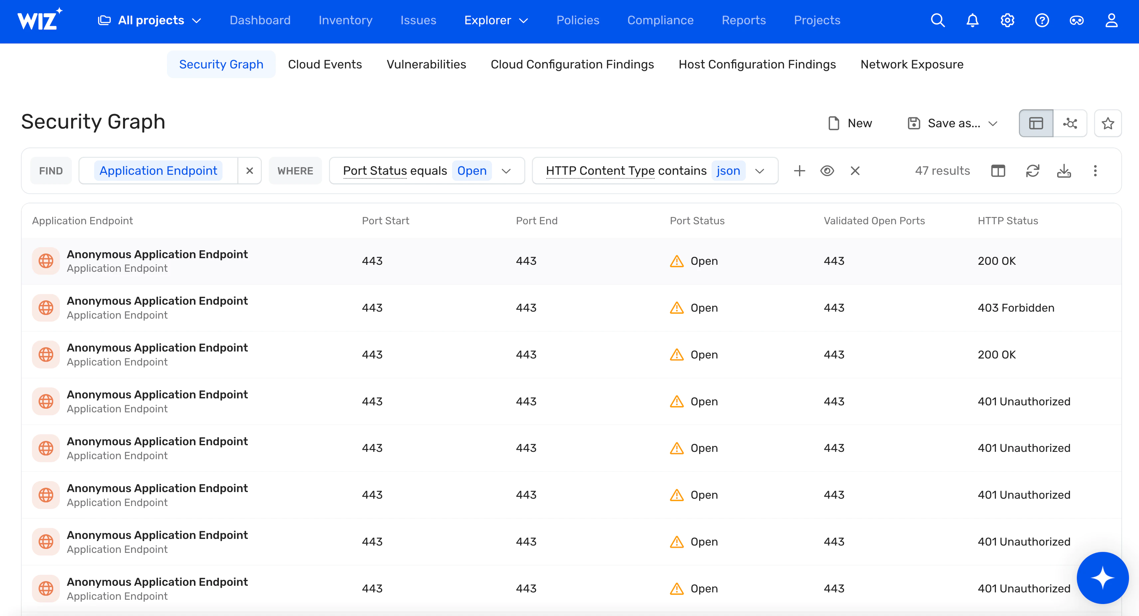
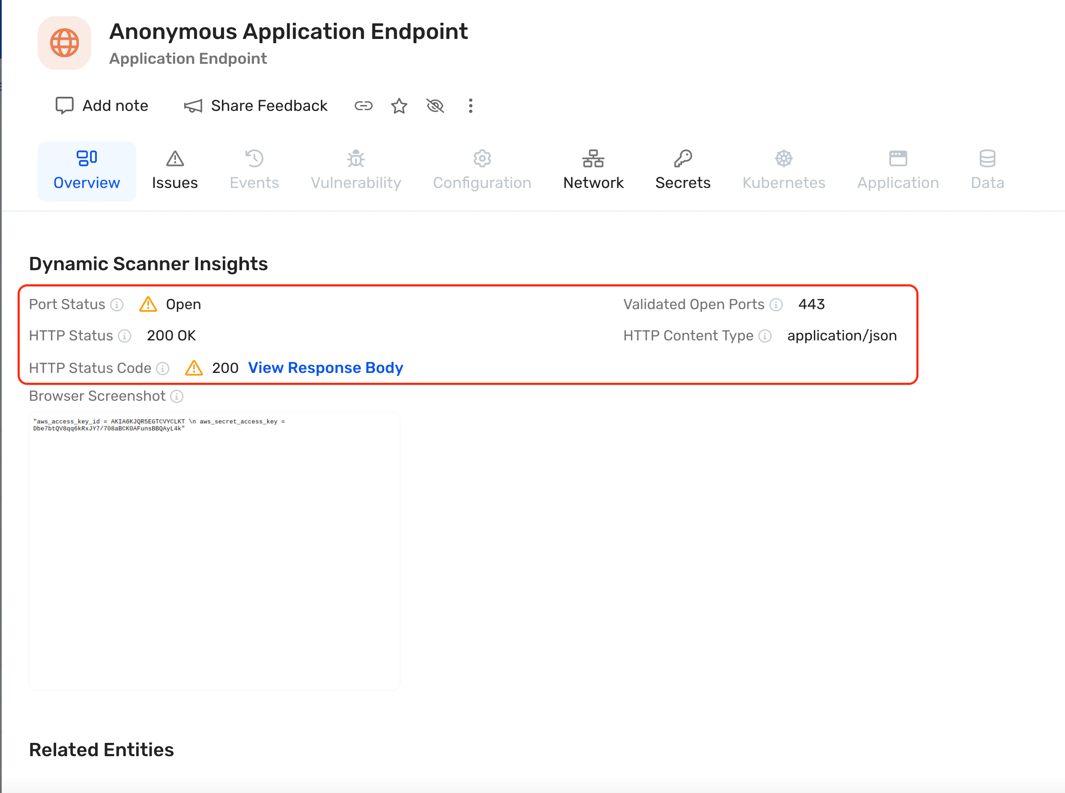
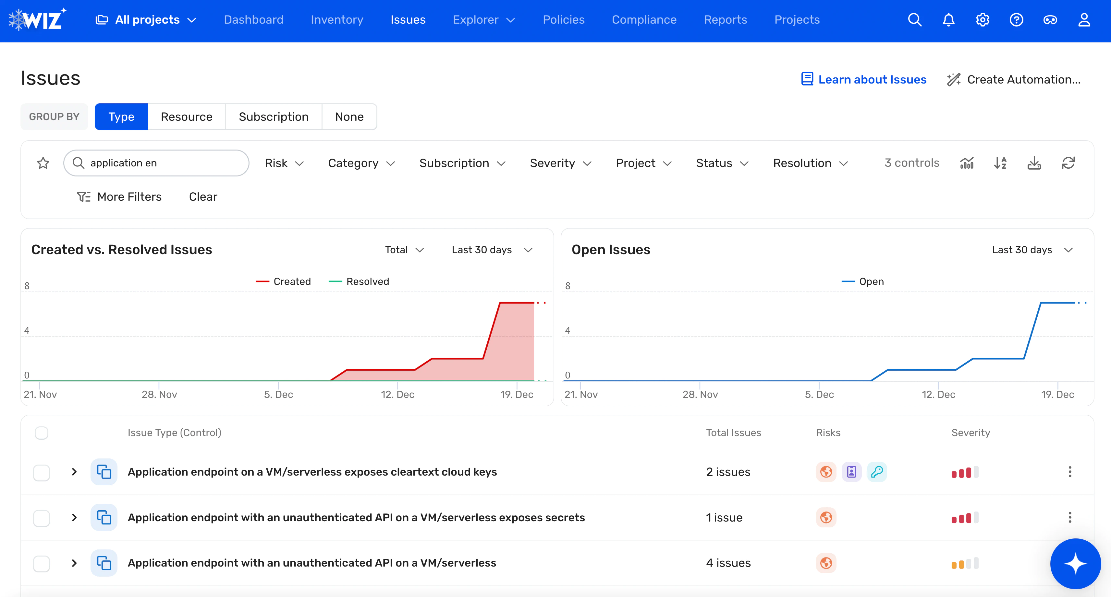
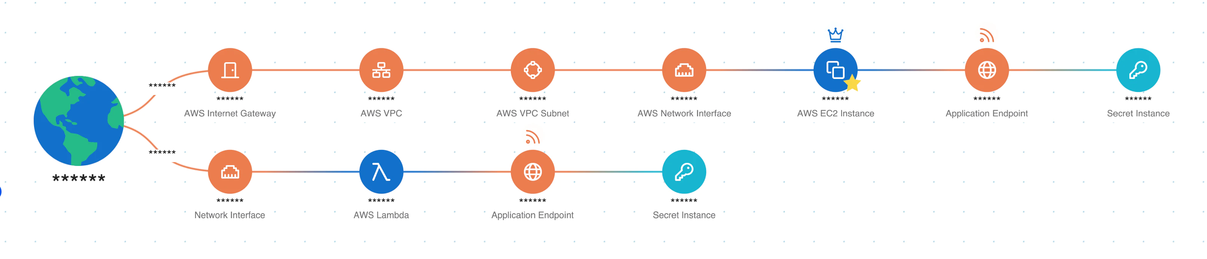
An approach to API Security risks
1. Continuously discovers APIs in the Wiz Inventory
2. Analyzes and validates externally exposed APIs
3. Detect unauthenticated APIs that expose secrets or sensitive data
4. Automate alerts when non-compliant APIs are detected
Notes:
How can we go about this type of API security risks? There are broadly two approaches
(a) inside-out: you look at the internal API configurations, schema and sensitive data
(b) outside-in – you can run tests from the Internet e.g. a pentest without prior knowledge
Here at Wiz what we think is the best approach is a combination of both. Here is our approach.
We first take an inside-out approach and discover APIs and their configurations
We validate them by sending some HTTP GET requests using our dynamic scanner
We correlate the unauthenticated public API with other risk factors like sensitive data and vulnerabilities
Lastly, as an out-of-band solution we trigger alerts to your team for remediation without causing potential false positives.

Slide 7
Cloud Threat: Lapsus$-like Attacks
Notes:
So this is API security in 2 slides. I know it’s a topic that warrants a dedicated session. But since we have other top threats to talk about, let’s move on.

Slide 8
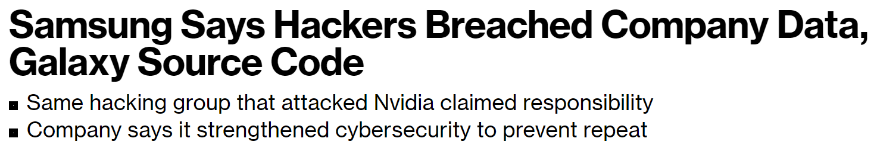
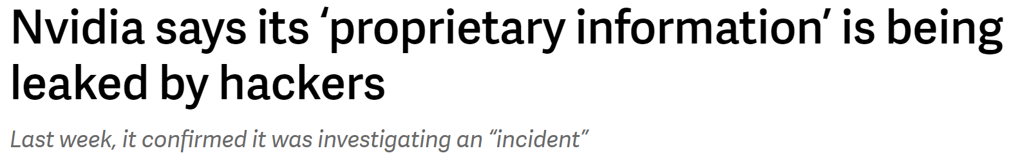
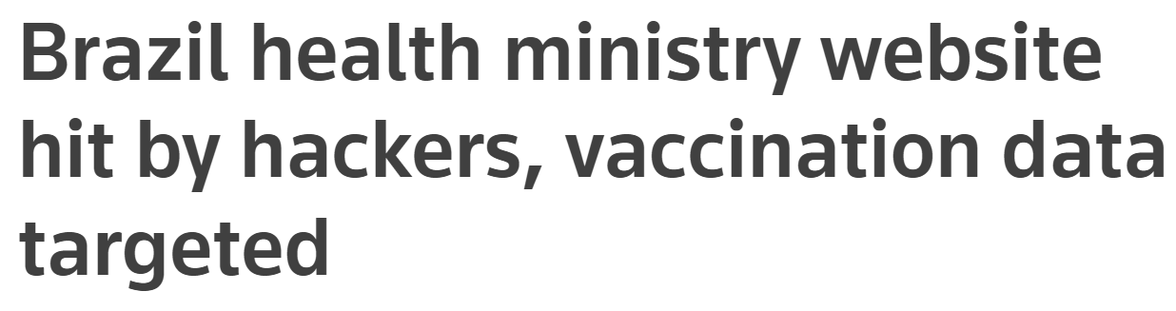
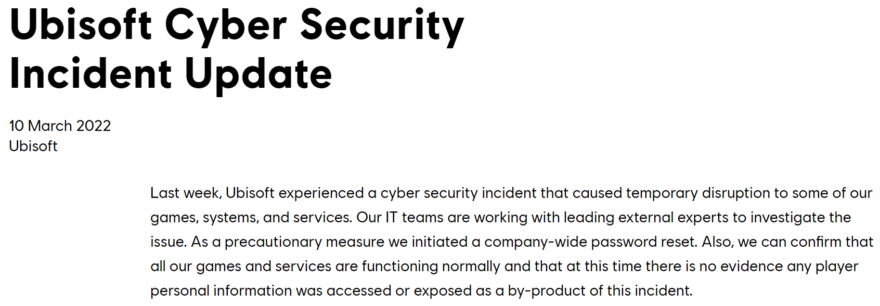
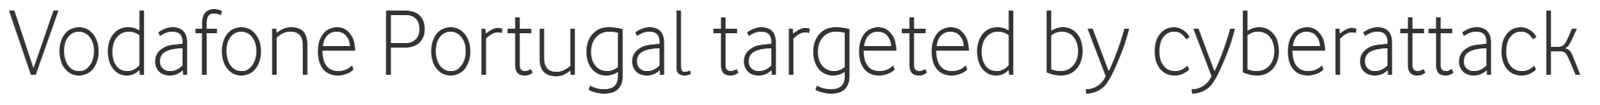
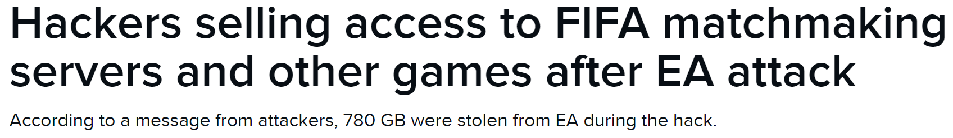
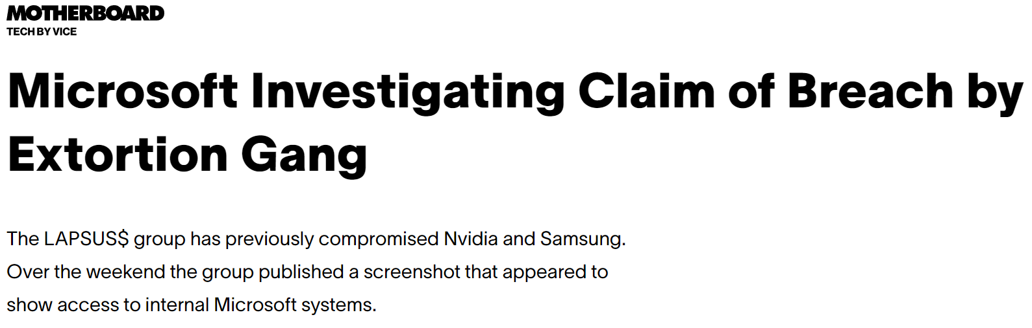
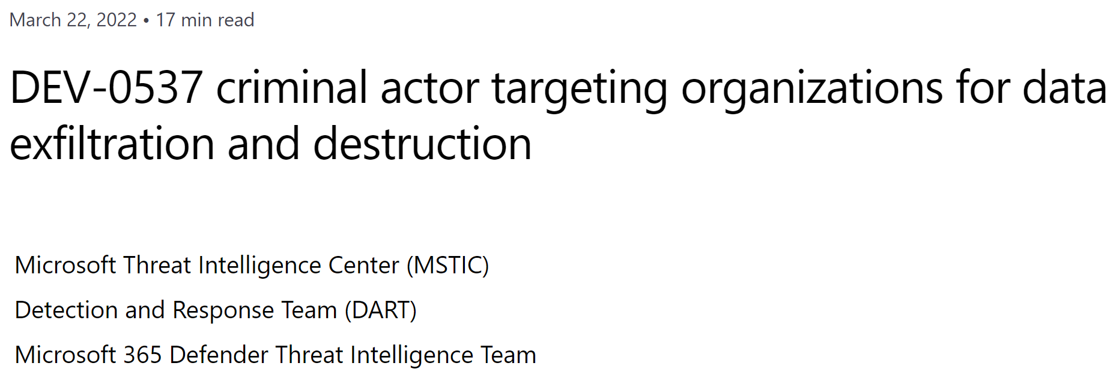
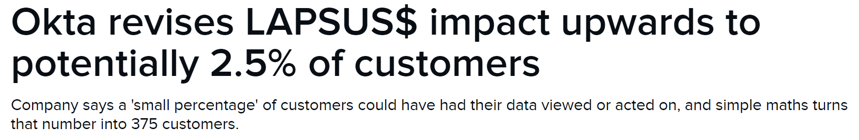
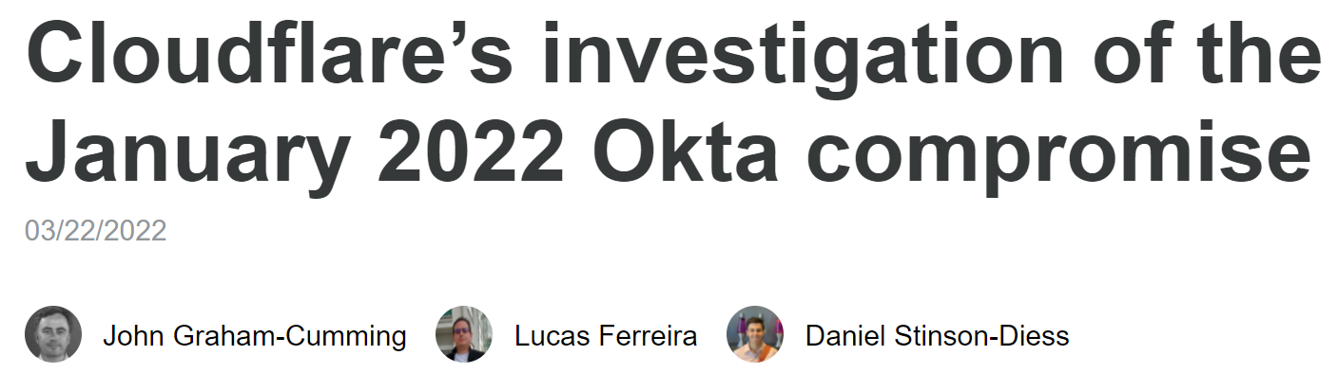

LAPSUS$: Cloud environment targeting
Notes:
Back in March 2022, the extortion gang known as LAPSUS$ made the news by targeting some well-known organizations including Micorsoft, Okta and Nvida. Similar to Optus story just now, the threat actors use the data stolen for extortion.
Instead of API, the approach used by LAPSUS$ is different.

Slide 9
LAPSUS$ Attack Flow
Initial access via compromised users
Exploit unpatched apps and gather secrets, for privilege escalation
Reach internal resources and exfiltrate data
Notes:
Generally speaking, we can identify three stages in LAPSUS$’s attack flow.
In the first stage, LAPSUS obtains initial access to the target systems by impersonating user accounts via stolen credentials or by infiltrating publicly exposed resources. The effective attack surface at this stage is primarily the externally accessible user accounts, even privileged ones.
Once LAPSUS gain access to a target account, it sets out to abuse the permissions of whatever accounts are accessible to them. To this end, they search for exposed secrets on internal resources, and attempt to exploit vulnerable internal systems and escalate their privileges in the target cloud infrastructure environment.
In the 3rd stage, LAPSUS uses escalated privileges in order to expand access and control within the cloud environment, until they reach resources containing valuable assets such as code or sensitive information that can be used for extortion.
When I took a step back and looked at the attack flow. It is not all that different from the many other attacks before: initial acccess, privilege escalation, and data exfiltration.
What makes LAPSUS special the use of targeted social engineering, bribery, and MFA bombing in the 1st stage, and then leverage cloud in the 2nd stage.
https://www.darkreading.com/vulnerabilities-threats/what-we-can-learn-from-lapsus-techniques
https://www.wiz.io/blog/hardening-your-cloud-environment-against-lapsus-like-threat-actor

Slide 10
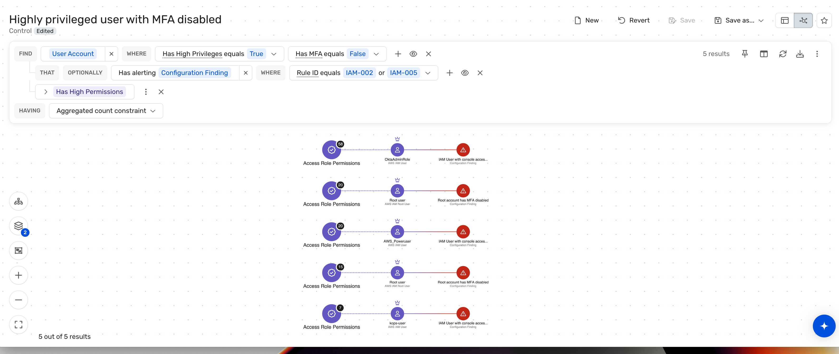
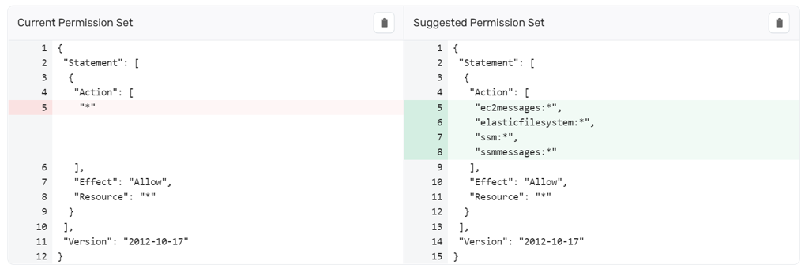
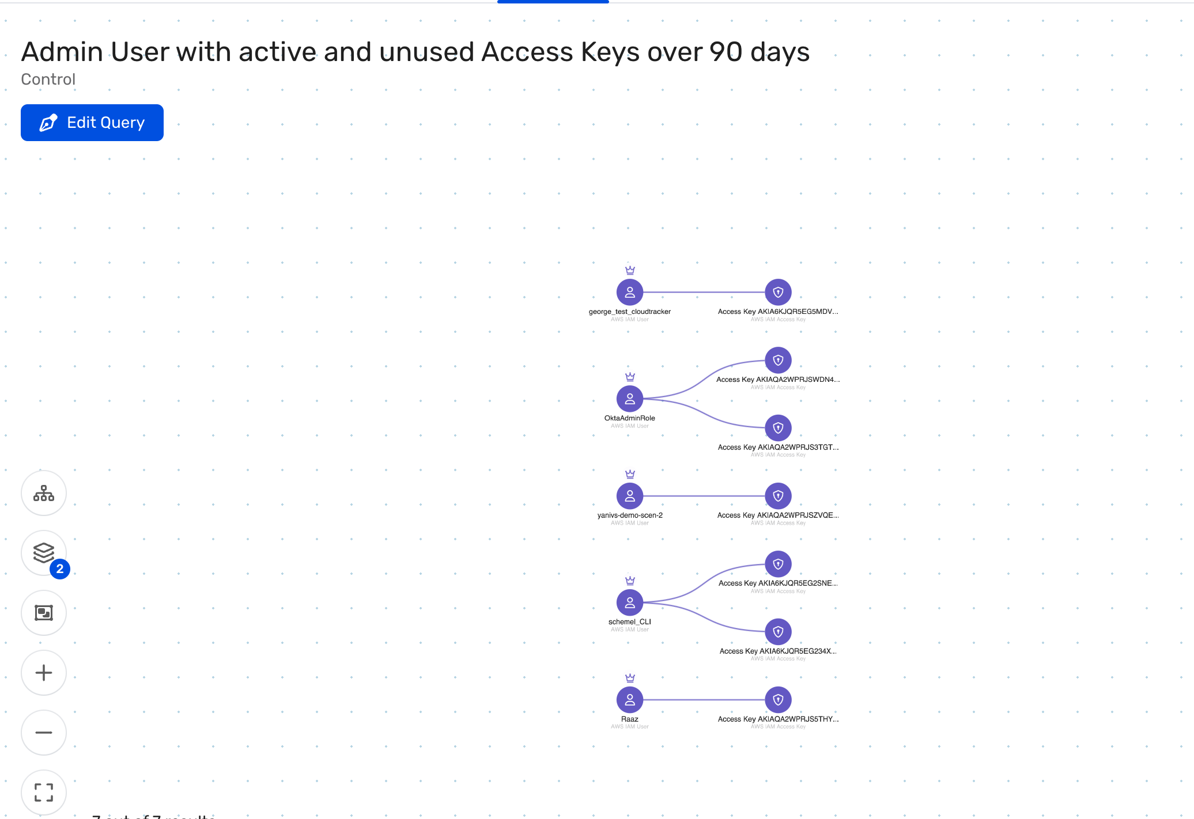
Steps to prevent Lapsus$ style attacks on cloud
Enforce MFA and require MFA for accessing sensitive resources
Revoke unnecessary permissions
Rotate access keys that have not
been rotated for over 90 days
Safeguard VMs from risky authentication methods
Patch sensitive systems and known targeted vulnerabilities
Notes:
Here is Wiz's approach to addressing the threats from LAPSUS groups in your cloud environments.
You can see none of them is new or ground-breaking.
The first step is to enforce MFA on your cloud accounts. Needless to say, this is basic hygiene
Secondly, by the principle of least privilege, you should revoke unnecessary permissions. Global admin permissions should be limited to specific dedicated service accounts, with trust policies explicitly permitting only specific highly trusted users to assume them. Moreover, you should review all highly privileged users and service accounts to ensure that they absolutely require all their permissions, and revoke any unnecessary permissions.
Thirdly, purge exposed secrets. As mentioned above, LAPSUS$ has relied on compromising user accounts as an initial access vector. They have sourced stolen credentials from underground forums, and publicly exposed secrets (such as Cloud customers should ensure that their secrets – such as API keys, encryption keys and tokens – are strictly managed, rotated often, and are not stored in cleartext on any publicly exposed resources.
Safeguard VMs from risky authentication methods. Ensure SSH or RDP authentication use keys, or at least strong passwords. The local root user should never use a password for SSH authentication. Additionally, restrict the SSH and RDP connections to only known IP ranges, and ideally require MFA for these connections as well.
Last but not least, patching. You should prioritize systems containing sensitive information, and s those with critical vulnerabilities.

Slide 11
Cloud Threat: Data exposure
Notes:
Now let's take a look at the top 5 cloud threats. These threats were chosen by the Wiz Research Team after a thorough analysis according to these pillars:
The impact on cloud environments and the growth of the threat prevalence,
Threat intel sources,
Attacks in environments that we've witnessed,
and our own research

Slide 12
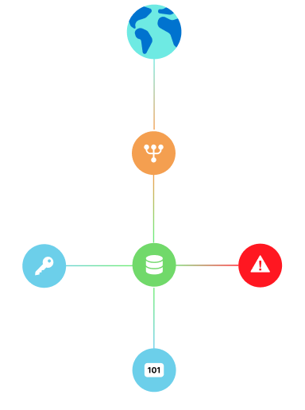
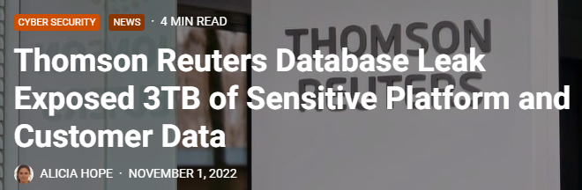
Thomson Reuters exposed database
Internet
ELB
Credentials
Elastic
Search
Data
Finding
Data
Notes:
Back in November 2022, the security researcher found publicly exposed non-production ElasticSearch DB.
The ElasticSearch is for collecting applicaiton logs from the pre-prod environment.
The 3TB data leak contains various secrets and PII, including:
Access credentials to 3rd-party servers in plaintext
Password reset logs listing customer Email addresses
Customer search history
Exposure apparently caused by misconfigured AWS ELB
https://cybernews.com/security/thomson-reuters-leaked-terabytes-sensitive-data/
https://www.cpomagazine.com/cyber-security/thomson-reuters-database-leak-exposed-3tb-of-sensitive-platform-and-customer-data/

Slide 13
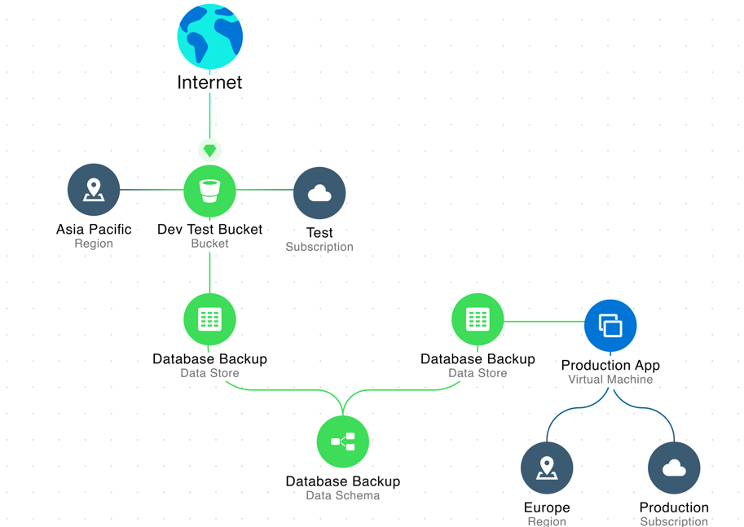
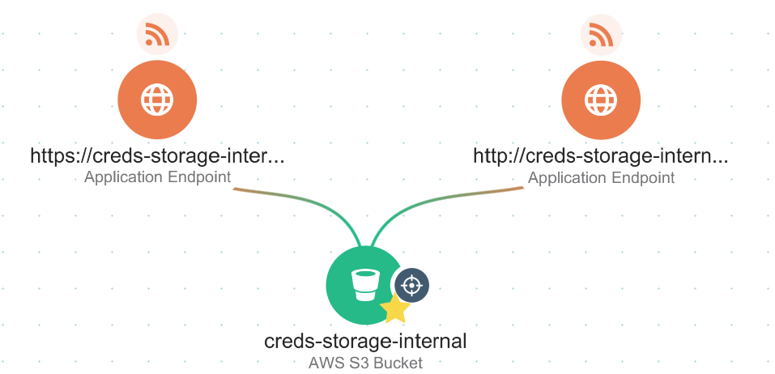
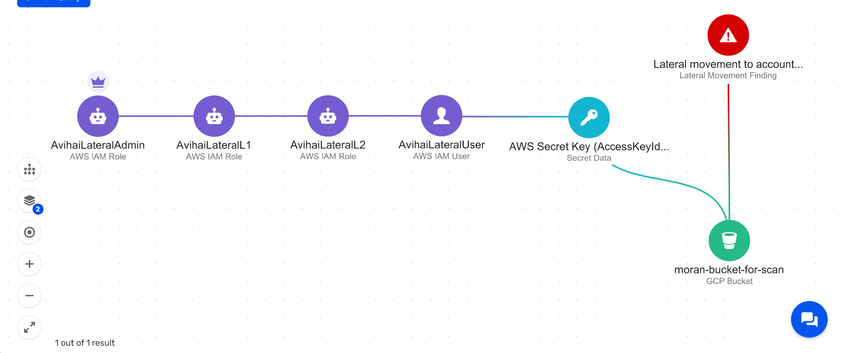
Steps to remediate data exposure risks
Identify exposed datastore
Track secrets for lateral movement
Track data lineage
Notes:
Here are the steps to remediate data exposure risks
Firstly, it is to identify the exposure datastore.
Secondly, check the data for secrets like connection strings, which can lead to lateral movement.
Thirdly, the sensitive may not exist in one location. You can the use data schema to trace the data lineage. Data lineage includes the data origin, what happens to it, and where it moves over time

Slide 14
Supply chain attacks
Notes:
The last threat I’m talking about today is software supply chain.

Slide 15
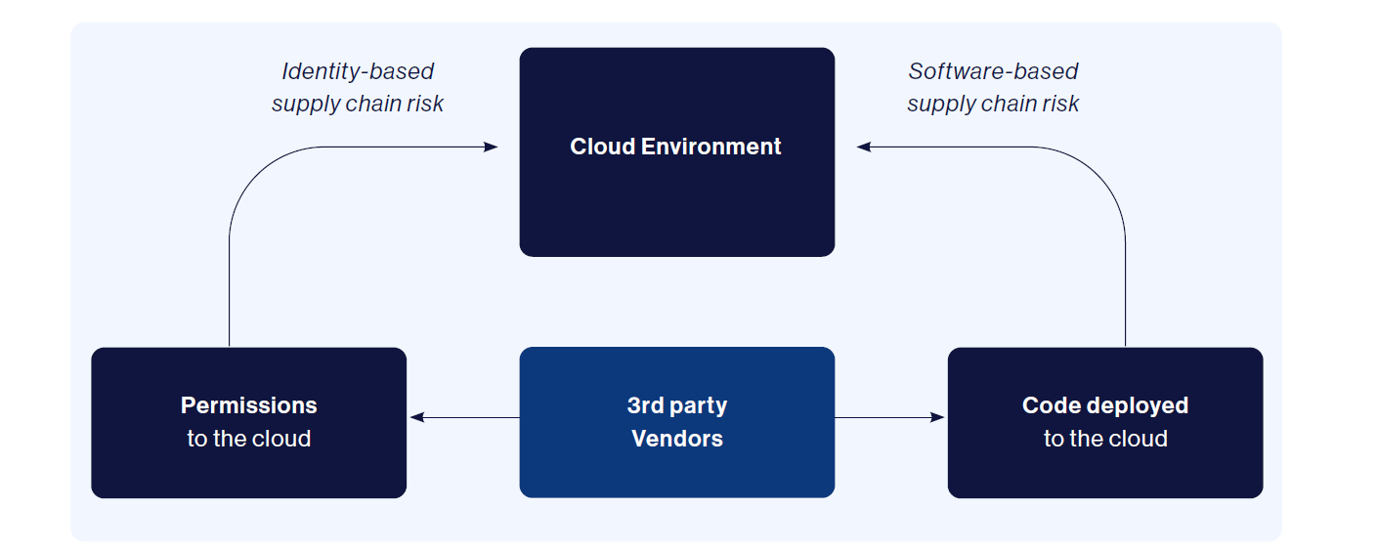
Supply chain risk in the cloud
Notes:
What is the software supply chain on the cloud? As organizations build out cloud footprints, it’s not feasible to build everything from scratch. Organizations buy commercial software, using open source tools and integrating everything into their cloud infrastructure. This introduces 2 types of supply chain risks: software-based and identity based.
With the software-based supply chain, the risks are introduced by vulnerable or malicious software code.
With the identity-based supply chain, the risks are introduced by 3rd party permissions.

Slide 16
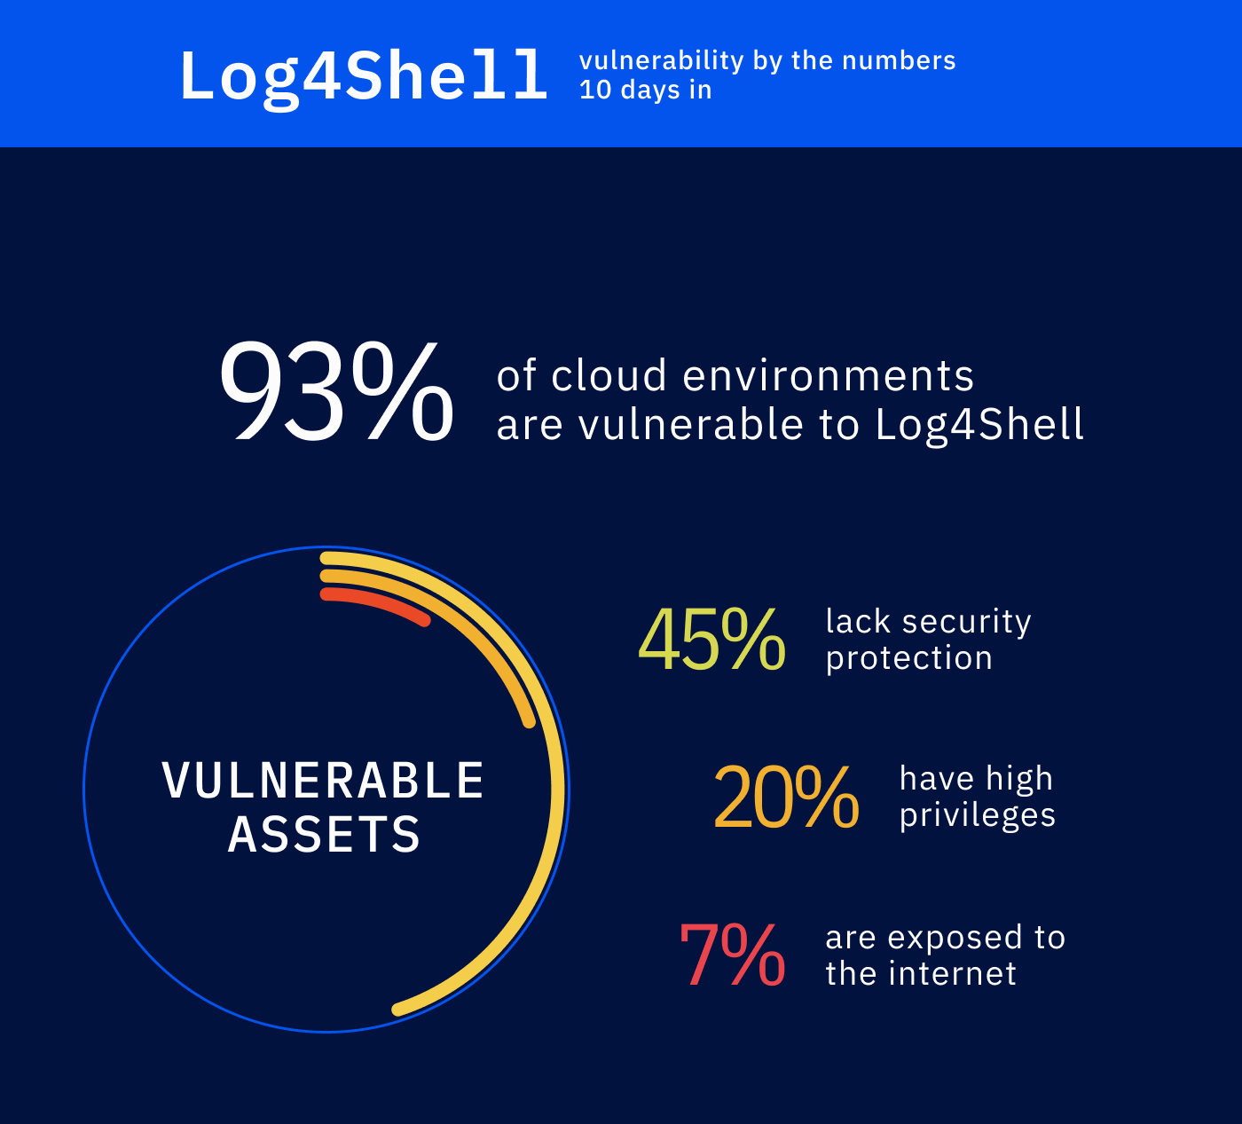
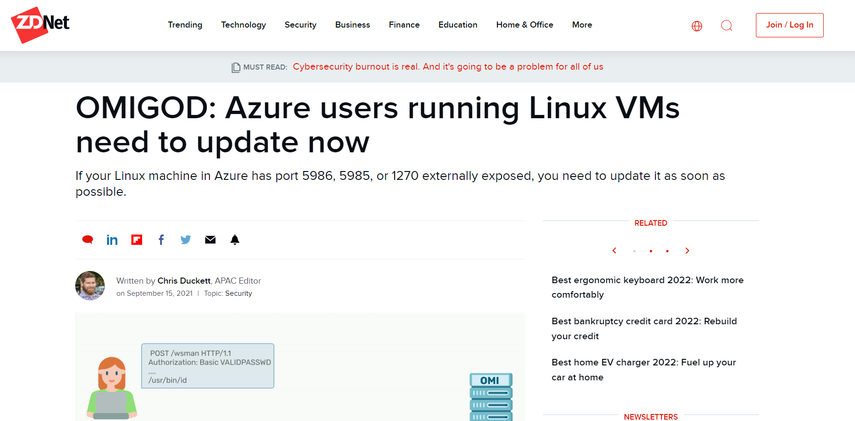
Supply chain risk – software-based
Log4Shell affected dozens of cloud services, thousands of applications
OMIGOD – vulnerable preinstalled agent affecting 60% of Azure users
Notes:
For software-based supply chain attacks, we can start with the classic example of Log4shell. There were plenty of customers we met with who were sure they didn't have any Log4shell running in their environment. When we'd actually investigate, there were plenty of log4j vulnerabilities due to vendors that they were using and integrating. In fact, according to a joint research done by Wiz an EY, 93% of all cloud environments are at risk from Log4Shell 10 days after its publication.
Another example is OMIGOD, an RCE vulnerability found by Wiz threat research team. We found the critical vulnerabilities in the Azure OMI (Open Management Interface), which is a ubiquitous software agents preinstalled on a large portion of Linux VMs in Azure. We estimate around 60% of azure users were actually affected by this. Organizations are unknowingly put at risk in these types of situations
As mitigation, the key is to first to identify the software supply chain and then remediate those vulnerabilies, malware, misconfigurations and so on.

Slide 17
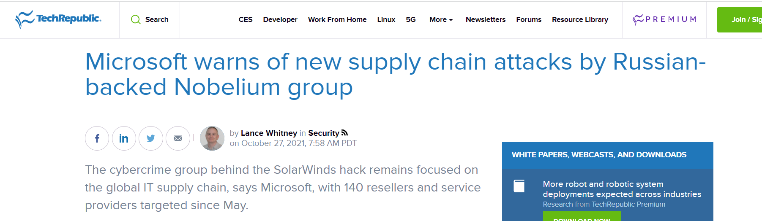
Supply chain risk – identity-based
Example - Nobelium threat actor group
Nobelium (the group behind the SolarWinds hack in 2020) targeted multiple CSPs and MSPs
The attackers' goal was to leverage these trusted relationships to move laterally in cloud environments, from the service providers to their customers
Notes:
Now let’s look at the other type of supply chain risk, which is identify-based.
The SolarWinds hack was an example of exactly that. The threat actor group behind it, Nobelium, targeted cloud providers and managed service providers to utilize the relationships and move laterally through customer environments. At Wiz, I often see that customers are giving third parties highly privileged access to their environments, which could result in this exact attack. Threat actors are well aware of this weakness in the identity supply chain. When you are providing vendors access, consider the permission given and the potential impact and blast radius.

Slide 18
Threats and cloud security best practices
API Attacks
Proactively discover, analyze and enforce API controls
Lapsus$ style attacks
Strong identity hygiene and patch vulnerable systems
Data exposure
Review your PaaS DBs and compute workloads
Supply chain attacks (Software)
Scan and prioritize vulnerable resources
Supply chain attacks (Identity)
Validate 3rd party software permissions
Notes:
Now lets start thinking of some solutions to the problems we just spoke about.
I don’t actually think any of the best practices are new to you. What matters is how to apply them to your cloud environment.

Slide 19
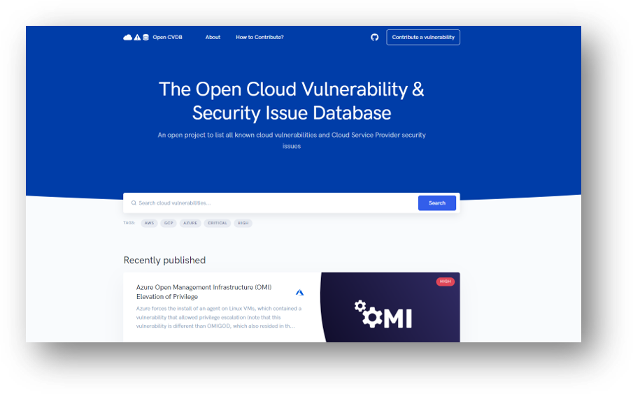
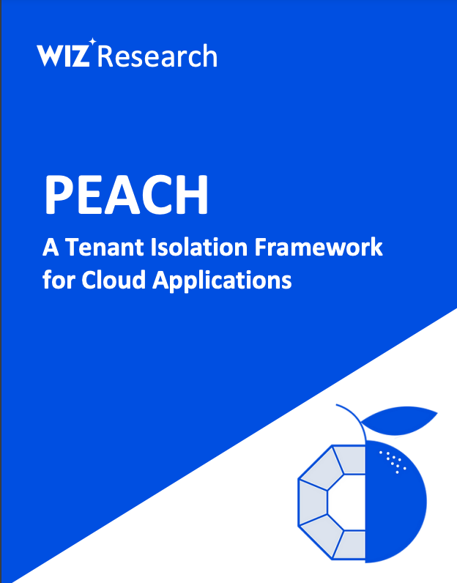
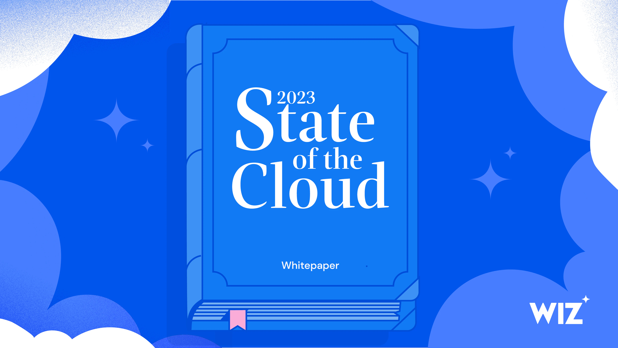
Stay up to date with the latest cloud threat research
Notes:
Here comes the end of my presentation. Thanks for your time. Looking forward to talking to you at the Wiz booth,

